Slide 1
Network Security
By Aiden Stopforth(EDUV4849965), Chad Brehem(EDUV4938975), Erin Sierra(CON-1546203-D0J0), Keenan Batista(EDUV4845350)
25 March 2025

Slide 2

Network Plan & Design
Designed using Cisco Packet Tracer
Represents three floors of infrastructure
VLAN-based topology for scalability

Slide 3
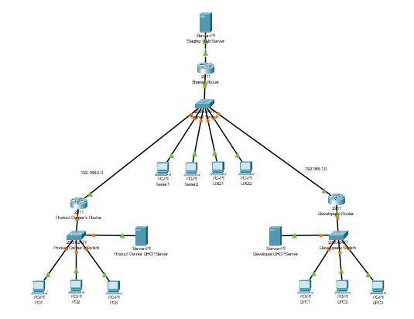
Network Plan & Design
Network Topology: Star Topology
Floor-wise device distribution
Central switch interconnecting floors
VLANs for efficient traffic management

Slide 4
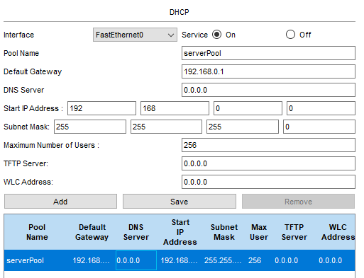
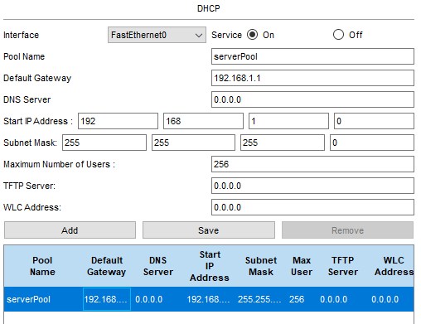
DHCP Server Configuration
DHCP assigns IP addresses automatically
Reduces manual configuration
Improves network efficiency

Slide 5
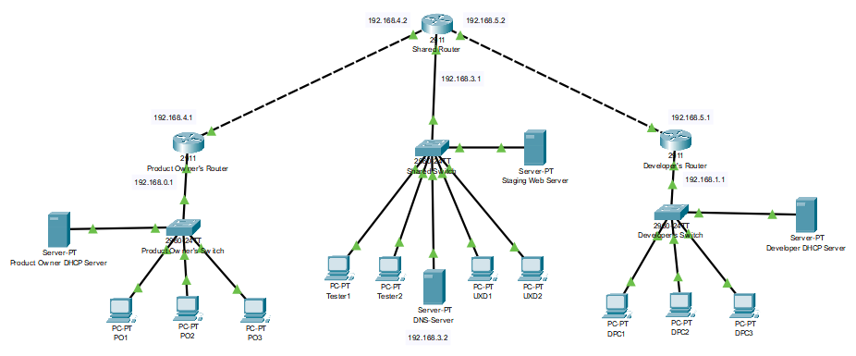
Maps domain names to IP addresses
Enables easier communication across subnets
DNS Configuration

Slide 6
VLANs Implementation
VLANs separate network traffic for security & efficiency
Each department assigned a VLAN
Reduces broadcast traffic

Slide 7

VLANs Implementation
VLAN 10: Testers
VLAN 20: UX Developers
VLAN trunking used for inter-switch communication

Slide 8
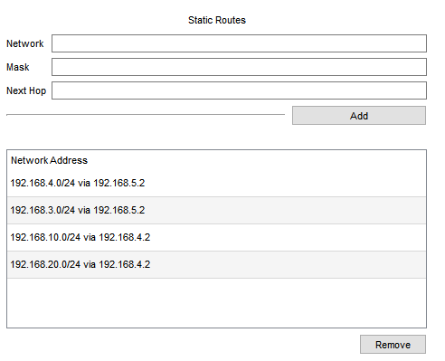
Shared Router Configuration
Routes traffic between VLANs & internet
Shared between Floor 2 and Floor 3

Slide 9
ACL Configuration
Blocks unauthorized traffic
Restricts access between VLANs

Slide 10
NAT & Port Forwarding
NAT assigns public IPs for external access
Port forwarding for staging web server

Slide 11

ACL Rules & Security
Restrict unauthorized access to staging server
Enforce internal security protocols

Slide 12

Development Team Permissions
Defined permissions for development team
Prevents unauthorized configuration changes

Slide 13
Design Discussion
Initial design limitations
Future improvements: Load balancing, automation

Slide 14

RIP Enablement
RIP used for dynamic routing updates
Simplifies routing table management

Slide 15

Backup Link Implementation
Backup link ensures continuous connectivity
Prevents network downtime

Slide 16
RIP & OSPF Challenges
Challenges:
Routing Protocol Differences
Redistribution Complexity
Administrative Distance Conflict
Convergence Time Differences
Inconsistent Network Topology Views
Scalability Concerns

